Slide 1
British Airways
Predictive model and its results
By Nurlan ismayil
2022-11-09

Slide 2
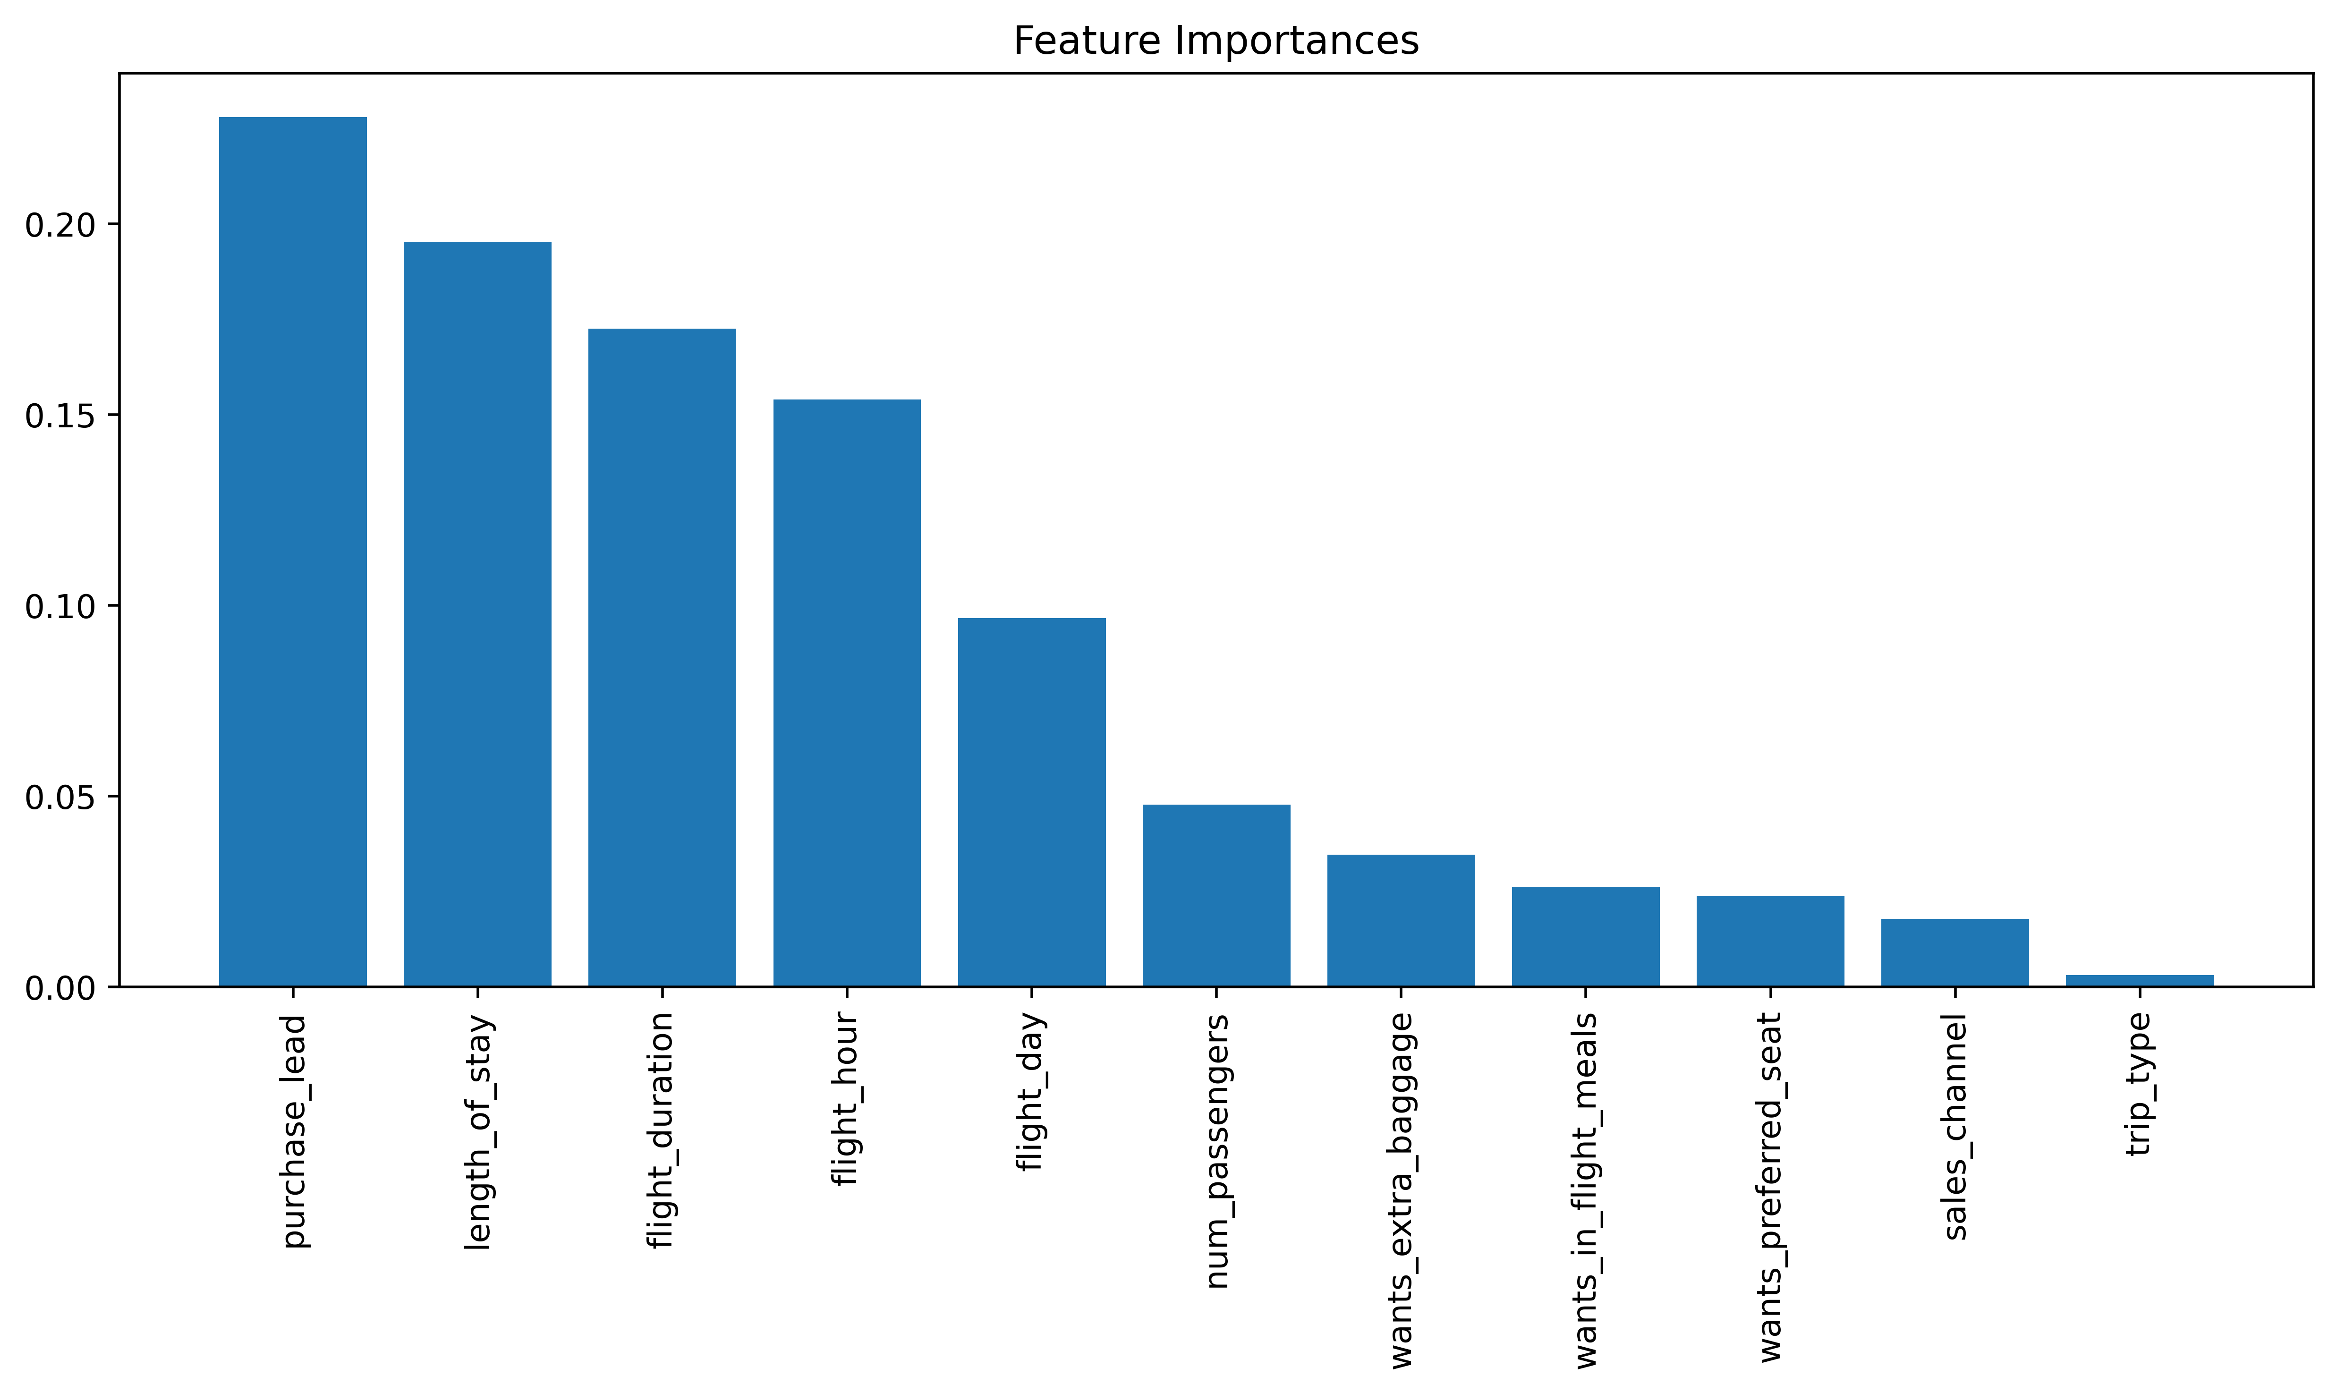
Findings from predictive modeling
0.69
Our focus lies in accurately forecasting unsuccessful bookings. While an imbalanced dataset can yield greater accuracy, it fails to precisely predict unsuccessful bookings. The dataset was adjusted, containing 8000 labelled as incomplete bookings and 7478 as successful bookings.
Performance Reporting for balanced dataset is like below :
Accuracy: 0.69
Precision: 0.66
Recall: 0.71
F1-score: 0.69

